Slide 1
THE MAZE GAME
Submitted by
ALOK SINGH
Mrs. Neeru Goud
Supervisor

Slide 2
AGENDA
DEFINITION
SCOPE
METHODOLOGY
DFD LEVEL
MODULE SPECIFICATIONS
CONCLUSION

Slide 3
DEFINITION
It's a place with high walls or hedges, where you wander around and get lost. It's a little more complicated than that. Humanity has always enjoyed patterns. Some of the earliest patterns were spirals, either simple ones or double ones where you wound your way into the centre and out again. I think of these as pre-maze patterns. Later the Cretan (or classical) pattern arrived. Everyone agrees that this is a maze, but it has no choices.

Slide 4
SCOPE
Their goal is to find the secret path and get everyone from the start point to end. Students take turn according to their number and they each get a chance to guess where the path is.
Mazes have essentially possible objective to escape, to get the prize, to trace a path, to be a metaphor, to be a stage. Mazes are essentially the puzzles that we initially have on paper which we often see children solving from a small age.

Slide 5
METHODOLOGY
The game in which there is a start point where person has to start from a point and have to find the way to solve it and have to take the pickle/coin etc to the end point.
As a group, their goal is to find the secret path and get everyone from the start point to end. People take turns according to their number and they each get a chance to guess where the path is.

Slide 6
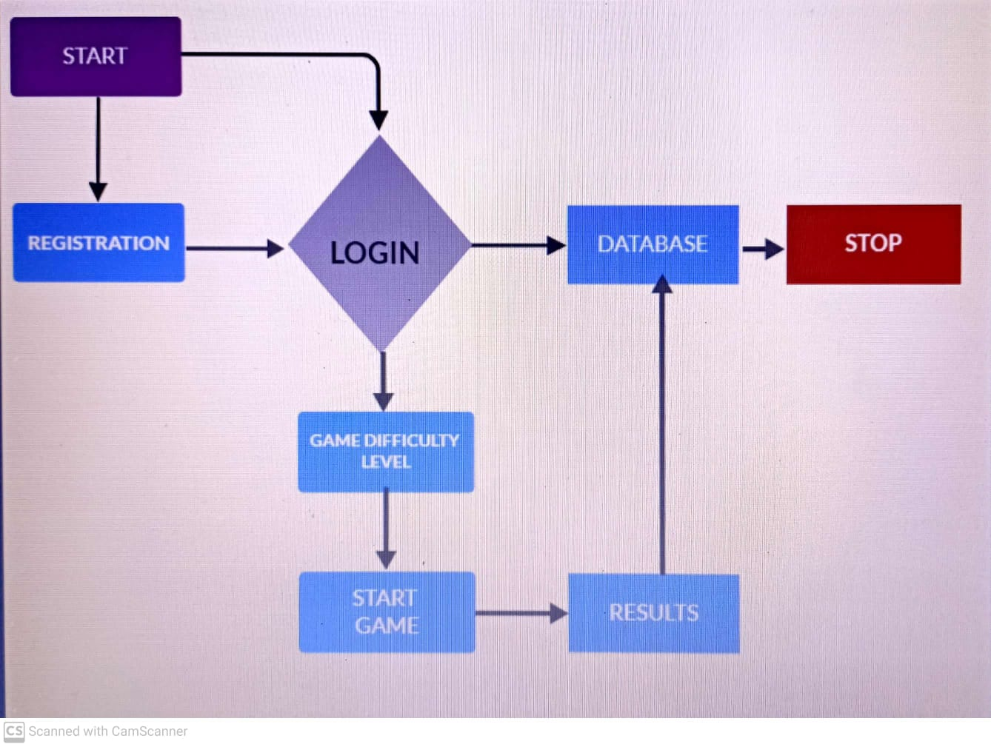
DFD LEVEL

Slide 7
MODULE SPECIFICATIONS
The Proposed system are divided into 4 types:
Registration
Login
Game Difficulty Levels
Results

Slide 8
CONCLUSION
In this approach, a Maze based game is thoroughly described. The proposed approach provides us a joyful game. In which we make a register page firstly where user can register themselves by just few steps like by entering their name, id, username and password. After that user will see a login page where they have to write their email-id and password so that user is able to enter the game interface .After that they have to select the level of difficulty as per their need and have to click on the start button to play the game . In this they have to find the right path and have to bring the pickle/coin to the end point by right path

Slide 9
THANK YOU

